Slide 1

Classification of You-Tube Videos using Deep Learning and NLP
(Supervisor: Dr Deepti Gupta )
GroupMembers
Department of Computer Science and Engineering
Name of Member | Roll Number | Role
Akash Kandpal | 1513310027 | NLP/ Deep Learning Part
Sivasish Koch | 1513310214 | Javascript Part for the browser
Saif Ali | 1513321165 | Classifcation checker (manual)
Rahul Bilra | 1513310161 | Scraping the data

Slide 2

Index
Project Acceptance Status and Suggestions given in Previous Presentation
Refined Problem Statement with literature Survey
Modules Summary
Brief Module details
Module Progress(in Tabular/Graphical form in terms of % completion)
Hardware /Software Requirement
Conclusion
References

Slide 3
Acceptance Status and Suggestions
The project has been accepted with some modifications. Suggestions were :
Reference are not proper.
PPT not in format.
Improve project name.

Slide 4
Problems in Existing System
Present State:
Software present currently are limited in scope and they don’t deal directly with improving the content of the You-Tube.
Currently the systems mainly focusses on building recommendation systems for You-Tube and like-wise video sites.
Till now You-Tube itself is not considering about categorizing the videos and checking the quality so an effort is required in this area.

Slide 5
Problems in Existing System
After implementation of project:
Quality score for all videos can be seen in the You-Tube itself.
No need for an additional app and the user-experience with the You-Tube videos will be maintained.
User can see the quality scores of the videos and like-wise decide as to which videos to watch and won’t waste time.
Building Recommendation videos will be easier after categorization of videos.

Slide 6
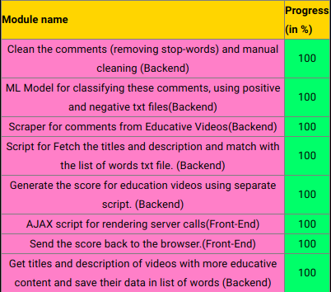
Module Summary

Slide 7
Module Details
Cleaning and analysis of comments is still in progress. We are collecting the most found words from the video and using them for generating the score about the educative content present in the video.
JS scripts are written for showing the generated score back on the screen.
Convnets are yet to be implemented after this the accuracy of videos will increase comfortably.
Research papers like audio-visual convergence will be implemented for generating quality scores for videos.
Deep NLP will be used for extracting better content from the comments.

Slide 8
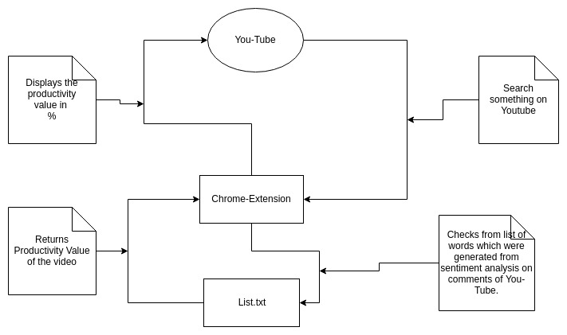
Module Details

Slide 9
DEMO
Installation Video
Demo

Slide 10
Conclusion
Our effort has been to make it easier for improving the quality content available on You-Tube and thus enhancing the user-experience of the You-Tube users. They can easily get relevant information from the videos. This has never been approached before as previously people have tried to make recommendation system for these platforms rather than doing something about the quality of content available over there.
Also, the approach involves further advancements like usuage of Deep NLP and Computer Vision for understanding the sentiments of the comments and also by analyzing the video itself frame-by-frame. So, this is a small effort from our side to improve the quality of videos and rank videos on You-Tube by providing them scores, lot of advancements will be seen in this area in the near future.

Slide 11
References
[1]Green BF, Wolf AK, Chomsky C, and Laughery K. Baseball: An automatic question answerer.
[2]Weizenbaum J. ELIZA - a computer program for the study of natural language communication between man and machine.
[3]Woods W. Progress in Natural Language Understanding - An Application to Lunar Geology.
[4]Bobrow DG, Kaplan RM, Kay M, Norman DA, Thompson H, and Winograd T. Gus, a frame-driven dialog system.
[5]Katz B. Annotating the World Wide Web using natural language.
[6]Clark P, Thompson J, and Porter B. A knowledge-based approach to question answering.
[7]Riloff E and Thelen M. A Rule-based Question Answering System for Reading Comprehension Tests.
[8]Reading Comprehension Tests as Evaluation for Computer-Based Language Understanding Systems, Vol. 6, 2000, pp. 13-19.
[9]Ittycheriah A, Franz M, Zhu WJ, Ratnaparkhi A and Mammone RJ. IBM’s statistical question answering system.

Slide 12
Thank You

Slide 13
Feedback from the Panel
The panel wants the team to :

